Slide 1
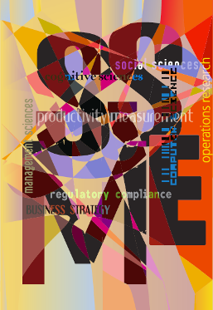

Service Science,
Management, and Engineering
(and Design, and Art…)
Five Years of Service Science
    Paul P. Maglio
    IBM Almaden Research Center
    Art and Science of Service V
    Bentley University
    June 18, 2009

Slide 2

Agenda
What is service science?
What are its basic ideas?
What has been going on?

Slide 3
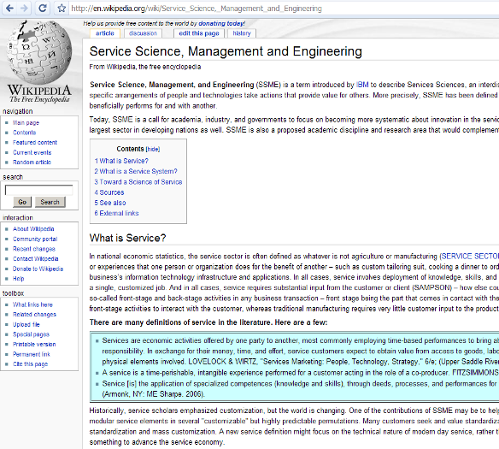
What is Service Science or SSME(D)?
Service Science, Management, and Engineering (SSME) is a term introduced by IBM to describe Service Science, an interdisciplinary approach to the study, design, and implementation of services systems – complex systems in which specific arrangements of people and technologies take actions that provide value for others. More precisely, SSME has been defined as the application of science, management, and engineering disciplines to tasks that one organization beneficially performs for and with another.

Slide 4
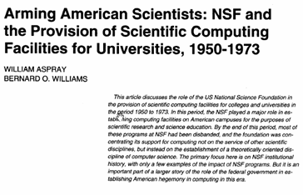
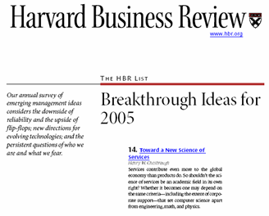
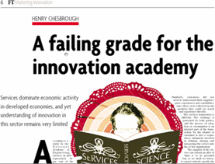
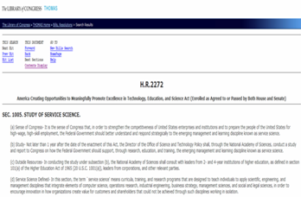
Service Science is about building common language
An analogy can be made with Computer Science. The success of CS is not in the definition of a basic science (as in physics or chemistry for example) but more in its ability to bring together diverse disciplines, such as mathematics, electronics and psychology to solve problems that require they all be there and talk a language that demonstrates common purpose.
Service Science may be the same thing, only bigger: an interdisciplinary umbrella that enables economists, social scientists, mathematicians, computer scientists and legislators (to name a small subset of the necessary disciplines) to cooperate to achieve a larger goal - analysis, construction, management and evolution of the most complex systems we have ever attempted to construct.

Slide 5
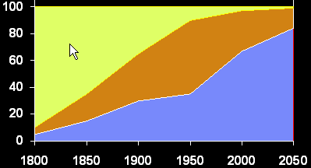
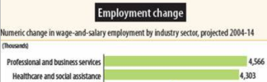
Service Sector Employment
Ten Nations
Total 50% of World Wide Labor
A = Agriculture, G = Goods, S = Services
US Employment History & Trends
1980-2005
PC Age
2005
United States
Nation
Labor
%
A
%
G
%
S
%
Service
Growth
(A) Agriculture:
Value from
harvesting nature
China
21.0
50
15
35
191%
India
17.0
60
17
23
28%
U.S.
4.8
3
27
70
21%
(G) Goods:
Value from
making products
Indonesia
3.9
45
16
39
35%
Brazil
3.0
23
24
53
20%
(S) Services:
Value from enhancing the
capabilities of things (customizing,
distributing, etc.) and interactions between things
Russia
2.5
12
23
65
38%
Japan
2.4
5
25
70
40%
Nigeria
2.2
70
10
20
30%
Bangladesh
2.2
63
11
26
30%
Germany
1.4
3
33
64
44%
International Labor Organization
The largest labor force migration in human history is underway, driven by global communications, business and technology growth, urbanization and
regional variations in labor costs
Notes:
All nations are experiencing a macro-economic shift from value in producing physical things (agriculture and goods) to value from apply capabilities for the benefit of others (services).
Observation: Service sector is where the job growth is, not only in the US but around the world.
Implication: Most science and engineering and management jobs will be in the service sector.
For example, Kenneth Smith of H.B.Maynard (one of the oldest and most prestigious industrial engineering consulting firms) said - “Historically, most of our business at H.B. Maynard was manufacturing, today roughly 80% is in the retail sector…”
So why do we still train most scientist and engineers for manufacturing age jobs? Could this be part of the reason that in most US engineering schools only 50% of entering engineering students graduate with an engineering degree?
The service sector is the fastest growing segment of global economies. In the US, in 1800 90% of people were worked on farms, and today less than 3% of workers are employed in agriculture. Goods, or manufacturing of physical products, peaked in the US in the mid-1950’s and has been decreasing ever since due to automation and off shoring. However, services, especially complex information and business services, as we will see is where the growth is. But the growth in the service sector jobs is not just in the developed countries, it is also happening in the developing countries. In fact, the International Labor Organization, reports that 2006 was the first time in human history that more people worker in the service sector than in agriculture world wide. 40% in service sector, 39.7% in agriculture, and 21.3% in manufacturing, with the growth coming by moving people from agriculture to services – this represents the largest labor force migration in human history.

Slide 6
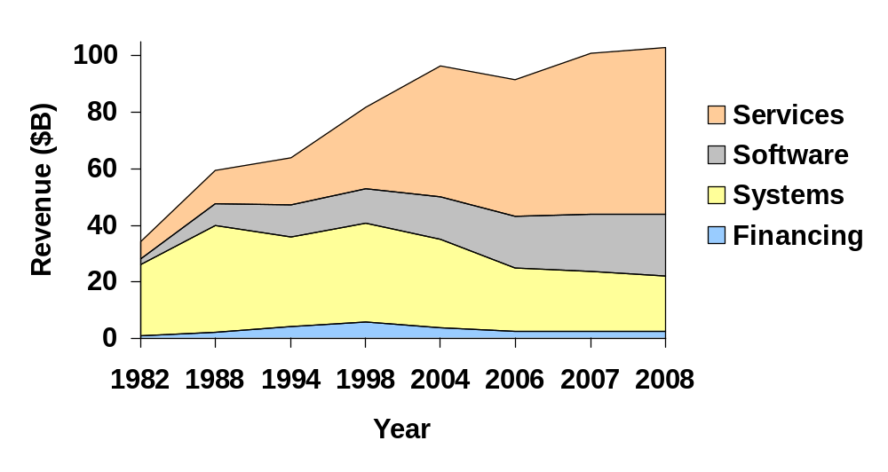
IBM’s business
2008 Pretax Income Mix
Revenue Growth by Segment
SYSTEMS
AND FINANCING
14%
42%
SOFTWARE
44%
SERVICES

Slide 7
A note on the phrase “Service Science”
This book concerns “service science,” Both words originate in Latin (Merriam-Webster 2003). The Latin root of service is “servus,” which means “slave, servant or serf,” while the Latin root of science is “scientia,” which means “knowledge.” In the ancient Latin, then, “servus scientia” would mean “slave knowledge.” … The term “service” has evolved from referring to people in subservient roles to broadly referring to activities performed for others. … the term “science” evolved from meaning knowledge in general to meaning specific kinds of knowledge that are discovered through rigorous methods of inquiry.
Many people who use the term “service science” today seem to employ “service” in its most modern meaning and “science” in its ancient meaning. … It is inaccurate to label the entire service field as “service science.” Instead, we suggest that the nomenclature in the service field should be similar in logic to the scientific nomenclature used in biology. The genus-species classification system allows flexibility across the vast range of life forms. With this logic, the word “service” should be considered the genus, which permits a large number of genus-species labels. The species become science, management, engineering, etc. In short, the service field should adopt a nomenclature that allows for and encourages flexible classification of service knowledge.
The word “science” may one day return to its original meaning of “knowledge,” but to avoid confusion and to be more precise, our chapter employs the phrase “service knowledge” instead of "service science" when we refer to whole of service knowledge. This chapter uses service science, service management, service engineering, and service arts in more specific ways as subsets of service knowledge.
Fisk, S. P. & Grove, S. J. (forthcoming). The evolution and future of service: Building and broadening a multidisciplinary field. In P. P. Maglio, C. Kieliszewski, & J. Spohrer (Eds). The Handbook of Service Science. New York: Springer

Slide 8
Many disciplines, many meanings of “service”
Service is an important concept
Service means…
  An economic measure
  A process
  A system or network
  A capability
  An experience
Service means…
  Value-cocreation between entities, phenomena in world
  The entities can be counted
  The entities have processes
  The entities are systems and form networks
  The entities have capabilities
  Some entities can “experience” value
Economics and Social Sciences
Marketing, Operations, and Management Science
Industrial and Systems Engineering, and Systems Science
Computer and Information Science
Psychology and Behavioral Sciences
Notes:
Just ask yourself, how many times a day you are a customer – average is about 40 times a day for an adult in a city on a work day who commutes to work…
John Ricketts a Distinguished Engineer in IBM Global Technology Services has written a book about applying theory of constraints to improve Professional-Technical-Scientific services, or knowledge-intensive labor-based service businesses.
The second step in apply TOC is to utilize the constraint to its fullest extent… The third step in applying TOC is to make sure that non-constraints keep the constraint busy – but otherwise stay out of its way… The fourth step in applying TOC is to improve the productivity of the constraint… The final step in applying TOC is to repeat the previous steps

Slide 9
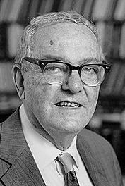
Service is part of the Artificial (Human-made) World
1. Understanding the Natural and Artificial World
2. Economic Rationality: Adaptive Artifice
3. The Psychology of Thinking:
Embedding Artifice in Nature
4. Remembering and Learning:
Memory as an Environment for Thought
5. The Science of Design: Creating the Artificial
6. Social Planning: Designing the Evolving Artifact
7. Alternative Views of Complexity,
8. The Architecture of Complexity:
Hierarchic Systems
The Sciences of the Artificial Herbert Simon (3rd ed, 1996)
Notes:
Herb Simon gets my vote as the first service scientist. Fredric Bastiat gets my vote as the Aristotle of service science. The Newton and Einstein have yet to appear. We are just emerging from the categorize and correlate stage – and entering the causal explanation stage of service science.

Slide 10
Evolving Complexity of Natural Worlds and Service Worlds
(Natural: Physical Systems – Energy and Matter)
(Service: Physical Symbol Systems – Value and Resources)
Service: Information (Globally Integrated Formal Service System Entities)
Service Science
Service: Economics & Law (Formal Service System Entities)
Service Science
Gray
Area
Service: Anthropology (Informal Service System Entities)
Natural: Biology (Neural & Social Organisms)
Systems Science
Explain Evolution of Entities & Interactions
Natural: Biology (Multi-Cell Organisms)
Natural Science
Natural Science
Natural: Biology (Uni-Cell Organisms)
Natural: Chemistry (Molecules)
Natural: Physics (Atoms)
Spohrer, J. & Maglio, P. P. (in press). Service science: Toward a smarter planet. To appear in W. Karwowski & G. Salvendy (Eds.), Introduction to service engineering.
Notes:
For physic, chemistry, need to add planetary science or environmental science – weather matters to the formation of life
Physics – Planetary Ecology (Weather, Heating and Cooling Processes)
Biology – Biological Ecology (Neural & Social Organisms) – many positive feedback loops, in neural & social -> physical symbol systems
Service Ecology – Human Ecology (Globally Integrated Formal Service Systems)

Slide 11
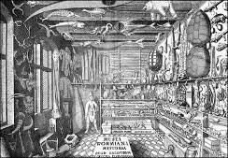
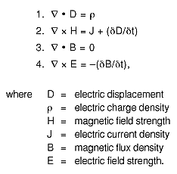
Science = Methods used by a community to both answer questions and to falsify and improve answers
Science is the agreed upon methods and standards of rigor used by a community to develop a body of knowledge that accounts for observable phenomenon with conceptual frameworks, theories, models, and laws that can be both empirically tested and applied within a world view or paradigm (Kuhn, 1962).
Two fundamental questions:
  How did we get here?
  (describe and explain; map and model)
  Where are we going?
  (predict and control; invest and improve)
Evolutionary perspective
  Structuration theory for social sciences (Giddens, 1986)
    Social structure and human agency coevolve
  Service dominant logic (Lusch and Vargo, 2004)
    Operand resources and operant resources coevolve
  Service science (Spohrer and Maglio 2008)
    Types of entities and interactions coevolve
Early Stage
Collect and Classify
(Biology)
Mature Stage
Unify and Mathematize
(Electro-Magnetism)
Notes:
Science tries to understand the essence of things, including how they change over time. From a service science perspective, the diversity of resources, service system entities that configure resources and value-propositions that interconnect with others are all of fundamental importance. How did the observed diversity of value-cocreation phenomena come into being and where might each instance going to evolve over time?
Service science adopts an evolutionary perspective, that structure (resources and service system entities) and action (interactions, both value-cocreation and governance) constrain each other in a coevolving way. The world begins via simple resource interactions and overtime more complex resources and interactions result, ultimately leading to physical symbol system (Newell 1980) interactions (entities with symbol manipulation and communication abilities), leading to informal service system interactions (behavioral norms), and then formal service system interactions (institutional laws). Structures and actions that enhance value-cocreation become self-reinforcing (Wright 2000). Service density increases as structures and actions create and use more resources and maintain high degrees of adaptive resource liquidity (Normann 2001). Resources that are not fully utilized provide opportunities. Potential resources — those have not yet been created — also provide opportunities.
Acknowledgements
Thanks to IBM and NSF grant IIS-0527770 for support. Portions of this presentation are from a book in preparation.
References
Abbot, Andrew (1988) The System of Professions: An Essay on the Division of Expert Labor. University of Chicago Press. Chicago, IL.
Allee, Verna (2002) The Future of Knowledge: Increasing Prosperity through Value Networks. Butterworth-Heinemann.
Alter, S. (2007). Service Responsibility Tables: A New Tool for Analyzing and Designing Systems. AMCIS 2007 Proceedings.
Anderson, J.C., N. Kumar, and J. A. Narus (2007) Value Merchants: Demonstrat and Documenting Superior Value in Business Markets. Harvard Business School Press. Cambridge, MA.
Ariely, D. (2008) Predictably Irrational. Harper Collins. New York, NY.
Baldwin, C.Y. and K.B. Clark (2000) Design Rules: The Power of Modularity. MIT Press. Cambridge, MA.
Beinhocker, Eric D. (2006) The Origin of Wealth: Evolution, Complexity, and the Radical Remaking of Economics. Harvard Business School Press. Cambridge, MA.
Bell, Daniel (1973/1999) The Coming of the Post-Industrial Society: A Venture in Social Forecasting. Basic. New York, NY.
Berry, L. L. 1980. Services marketing is different. Business (May–June) 24–29.
Bitner, M. J., Ostrom, A. & Morgan, F. (2008). Service blueprinting: A practical technique for service innovation. California Management Review, 50, 66 – 94.
Buchanan, Mark (2007) The Social Atom: Why the rich get richer, cheaters get caught, and your neighbors usually look like you. Bloomsbury, New York, NY.
Cataldo, M., K. Carley, L. Argote, (2001). The Effect of Personnel Selection Schemes on Knowledge Transfer. (URL: http://www.casos.cs.cmu.edu/publications/papers/marcelo_paper.pdf).
Chandler, Alfred D. (1977) The Visible Hand: The Managerial Revolution in American Business. Harvard Belknap. Cambridge, MA.
Chesbrough, H. (2004). A failing grade for the innovation academy. Financial Times (September 25) 6.
Chesbrough, H. and J. Spohrer (2006) A research manifesto for services science. Communications of the ACM. 49(7). July. 35-40.
Christopher, W. F. (2007) Holistic Management: Managing What Matters for Company Success. Wiley Series in Systems Engineering and Management.
Clark, C. (1940/1957) Conditions of Economic Progress. Third Edition. Macmillan. New York, NY.
Cohen, S. S. and J. Zysman (1988) Manufacturing Matters: The Myth of the Post-Industrial Economy. Basic, New York.
Collins, H. and M. Kusch (1999) The Shape of Actions: What Humans and Machines Can Do. MIT Press. Cambridge, MA. (See also: http://en.wikipedia.org/wiki/Interactional_expertise).
Cortada, James W. (2006)The Digital Hand, Volume 2: How Computers Changed the Work of American Financial, Telecommunications, Media, and Entertainment Industries. New York: Oxford University Press.
Diamond, Jared (2005) Collapse: How Societies Choose to Fail or Succeed. Viking. New York, NY.
Engelbart, D.C. (1962) Augmenting Human Intellect: A Conceptual Framework. Summary Report AFOSR-3223 under Contract AF 49(638)-1024, SRI Project 3578 for Air Force Office of Scientific Research, Stanford Research Institute, Menlo Park, Ca., October 1962.
Engelbart, D.C. (1980) "Evolving the Organization of the Future: A Point of View," Proceedings of the Stanford International Symposium on Office Automation, March 23-25, 1980.
Fagin, R., J.Y. Halpern, Y. Moses, and M.Y. Vardi (2003) Reasoning about Knowledge. MIT Press. Cambridge, MA.
Fitzsimmons, J.A. and M.A. Fitzsimmons (2007) Service Management: Operations, Strategy, Information Technology w/Student CD. 6th Edition. McGraw-Hill/Irwin. New York, NY.
Foray, D. (2006) The Economics of Knowledge. MIT Press. Cambridge, MA.
Friedman, Daniel (2008) Morals and Markets: An Evolutionary Account of the Modern World. Palgrave MacMillian. New York, NY.
Giddens, Anthony (1986) The Constitution of Society: Outline of the Theory of Structuration. Univesity of California Press. Berkeley, CA.
Glushko, R. J. and McGrath, T. (2005). Document Engineering. The MIT Press, Cambridge, Massachusetts.
Glushko, R. J. and L. Tabas (in press). Designing service systems by bridging “front stage” and “back stage”. Information Systems and e-business Management.
Grady, Jeffrey O. (2006) Systems Requirements Analysis. Academic Press. Burlington, MA.
Grasso, D, and D. Marinelli (2007) Holistic Engineering. The Chronicle Review. The Chronicle of Higher Education, March 16, 53(28), Page 8b.
Hefley, B. and W. Murphy (2008) Service Science, Management, and Engineering: Education for the 21st Century. Springer. New York, NY.
HPC Wire (2007) Earth Simulator Supercomputer to Help Insurers. Available at http://www.hpcwire.com/offthewire/17897414.html
IBM (2005). Services Sciences: A new academic discipline? Available at http://almaden.ibm.com/asr/SSME/facsummit.pdf
IfM and IBM. (2008). Succeeding through Service Innovation: A Service Perspective for Education, Research, Business and Government. Cambridge, United Kingdom: University of Cambridge Institute for Manufacturing. ISBN: 978-1-902546-65-0
Innovate America, Report of the National Innovation Initiative, December 2004.
International Labour Organization (2008). Global Employment Trends 2008. Available at http://www.ilocarib.org.tt/portal/images/stories/contenido/pdf/LabourMarketInformation/get08.pdf
Jacobson, Ivar (1992) Object-oriented Software Engineering: A Use Case Driven Approach, ACM Press.
Kim, W. C. and R. Mauborgne (2005). Blue Ocean Strategy: How to Create Uncontested Market Space and Make Competition Irrelevant. Harvard Business School Press.
Kuhn, T. S. (1962). The structure of scientific revolutions. The University of Chicago Press.
Levy, F. and R.J. Murnane (2004) The New Division of Labor: How Computers Are Creating the Next Job Market. Princeton University Press. Princeton, NJ.
Lewis, William W. (2004) The Power of Productivity: Wealth, Poverty, and the Threat to Global Stability. University of Chicago Press. Chicago, IL.
Lusch, R. F. and S. L. Vargo (2006) The Service-Dominant Logic of Marketing: Dialog, Debate and Directions. M.E. Sharpe, Armonk, NY.
Maglio, P. P. and J. Spohrer (2008) Fundamentals of service science. Journal of the Academy of Marketing Science. Volume 36, Number 1 / March, 2008.
Maglio, P. P., Srinivasan, S., Kreulen, J. T., Spohrer, J. (2006). Service systems, service scientists, SSME, and innovation. Communications of the ACM, 49(7), 81-85.
Maglio, P. P., Vargo, S. L., Caswell, N. and Spohrer, J. (in press). The service system is the basic abstraction of service science. Information Systems and e-business Management.
March, J.G. (1991) Exploration and exploitation in organizational learning. Organizatinal Science. 2(1).71-87.
McKenna, Christopher D. (2006) The World's Newest Profession: Management Consulting in the Twentieth Century (Cambridge Studies in the Emergence of Global Enterprise). Cambridge University Press. Cambridge, UK.
Murphy, W. and Hefley, B. (2008). What’s new in service science, management, and engineering? Paper presented at 17th Annual Frontiers in Service Conference. Washington DC.
Nambisan, S. and M. Sawhney (2007) The Global Brain: Your Roadmap for Innovating Faster and Smarter in a Networked World. Wharton School Publishing.
Normann, R. (2001) Reframing Business: When the Map Changes the Landscape. Wiley, Chichester, New Sussex.
Reich, Robert (2007) Supercapitalism: The Transformation of Business, Democracy, and Everyday Life. Knopf. New York, NY.
Ricketts, J.A. (2007) Reaching the Goal: How Managers Improve a Services Business Using Goldratt’s Theory of Constraints. IBM Press. New York, NY.
Sanz, J. L., N. Nayak, and V. Becker (2006). Business Services as a New Operational Model for Enterprises and EcosystemsThe 8th IEEE International Conference on E-Commerce Technology and The 3rd IEEE International Conference on Enterprise Computing, E-Commerce, and E-Services (CEC/EEE'06), 2006.
Seabright, Paul (2005) The Company of Strangers: A Natural History of Economic Life. Princeton University. Princeton, NJ.
Simon, H.A. (1996) The Sciences of the Artificial. 3rd Edition. MIT Press. Cambridge, MA.
Slywotzky, Adrian, Richard Wise, and Karl Weber (2003) How to Grow When Markets Don’t. Warner Business Books, NY, NY.
Spohrer, J. & Maglio, P. P. (2008). The emergence of service science: Toward systematic service innovations to accelerate co-creation of value. Production and Operations Management, 17(3), 1-9.
Spohrer, J, P. P. Maglio, J. Bailey, D. Gruhl (2007) “Towards a Science of Service Systems”. Computer, 40(1), pp. 71-77.
Spohrer, J. & Kwan, S. K. (2009). Service Science, Management, Engineering, and Design (SSMED): An Emerging Discipline - Outline & References. Int. J. of Information Systems in the Service Sector, 1(3).
Sterman, John D. (2000) Business Dynamics: Systems Thinking and Modeling for a Complex World. Irwin McGraw-Hill. Boston, MA.
Svendsen, Ann and Laberge, Myriam (2007) Mapping a Stakeholder Network. Available at http://www.sfu.ca/cscd/cli/mapping.pdf
Teboul, J. (2006) Service Is Front Stage: Positioning Services for Value Advantage. INSEAD Business Press, Palgrave MacMillan.
United Nations (2007) Urban and Rural Areas Chart 2007. Available at http://www.un.org/esa/population/publications/wup2007/2007_urban_rural_chart.pdf
Vargo, S. L. and R. F. Lusch (2004) Evolving to a New Dominant Logic for Marketing. Journal of Marketing, 68, 1-17.
Vickers, G. (1995) The Art of Judgment: A Study of Policy Making (Rethinking Public Administration). Sage. Thousand Oaks, CA.
Vickers, G. (1983) Human Systems Are Different. Harper & Row. London, UK.
Weinberg, Gerald M. (1975/2001) An Introduction to General Systems Thinking. Silver Anniversary Edition, Dorset House Publishing.
Womack, J. P. and Jones, D. T. (2005) Lean Solutions: How Companies and Customers Can Create Value and Wealth Together. Free Press. New York, NY.
Wright, Robert (2000) Non-Zero: The Logic of Human Destiny. Vintage/Random House. New York, NY.Barson, R. Foster ,G. Struck, T. Ratchev, S. Pawar, K. Weber, F. & Wunram,

Slide 12
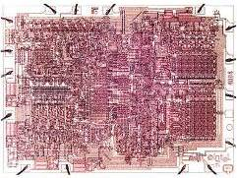
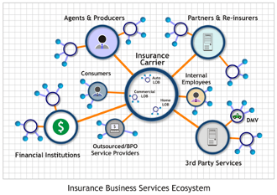
Grand Challenge: Laws of Service?
Computational power doubles at a predictable rate.
Are there analogous capability-doubling laws that apply in services?
Suppose that traces of human activity in particular service systems double at some rate, and that these human activity data lead to specific opportunities for improved or increased service productivity or quality.
Consider Amazon.com: The quality of recommendations depends on accurate statistics – the more purchases made, the better the statistics for recommendations.
Three improvement “laws” that might be applicable in services:
  The more an activity is performed (time period doubling, demand doubling), the more opportunities to improve.
  The better an activity can be measured (sensor deployment doubling, sensor precision doubling, relevant measurement variables doubling) and modeled, the more opportunities to improve.
  The more activities that depend on a common sub-step or process (doubling potential demand points), the more likely investment can be raised to improve the sub-step.

Slide 13
Service-dominant logic
Service is the application of competences for the benefit of another entity
Service is exchanged for service
Value is always co-created
Goods are appliances for delivery
All economies are service economies
All businesses are service businesses
Value Configuration
Density
Resource Integrator/Beneficiary
Resource Integrator/Beneficiary
(“Firm”)
(“Customer”)
Value Co-creation
Vargo, S. L. & Lusch, R. F. (2004). Evolving to a new dominant logic for marketing. Journal of Marketing, 68, 1 – 17.

Slide 14
Service is the application of competence for the benefit of another entity
Service involves at least two entities, one applying competence and another integrating the applied competences with other resources and determining benefit (also called, value co-creation).
We call these service systems.
A. Service Provider
Individual
Organization
Public or Private
B. Service Client
Individual
Organization
Public or Private
Forms of
Service Relationship
(A & B co-create value)
Forms of
Service Interventions
(A on C, B on C)
Forms of
Responsibility Relationship
(A on C)
Forms of
Ownership Relationship
(B on C)
C. Service Target: The reality to be
transformed or operated on by A,
for the sake of B
People, dimensions of
Business, dimensions of
Products, goods and material systems
Information, codified knowledge
Gadrey, J. (2002). The misuse of productivity concepts in services: Lessons from a comparison between France and the United States. In J. Gadrey & F. Gallouj (Eds). Productivity, Innovation, and Knowledge in Services: New Economic and Socio-economic Approaches. Cheltenham UK: Edward Elgar, pp. 26 – 53.
Spohrer, J., Maglio, P. P., Bailey, J. & Gruhl, D. (2007). Steps toward a science of service systems. Computer, 40, 71-77.

Slide 15

Service Science, Summary So Far
Definitions (for our purposes)
  Service = Value-Cocreation
  Science = Methods to answer questions
  Artificial = Human-made world (Service World)
Understand Relationship
  Systems Science = systems in natural world and artificial world
  Service Science = systems in artificial world
Fundamental Questions (for any Science)
  How did we get here?
    Describe & Explain
    Map & Model
  Where are we going?
    Predict & Control
    Invest & Improve
    Crisis & Recovery

Slide 16
Service Science key concepts
Ecology
(Diverse Entities)
Entities
(Systems)
Interactions
(Networks)
Outcomes
(Value Changes)
Value Proposition
Based Interactions
Governance Mechanism
Based Interactions
Access Rights
Measures
lose-win
win-win
Resources
Stakeholders
lose-lose
win-lose
Smarter systems serve customers better and improve quality of life,
creating more opportunities for win-win, or benefit-benefit, interactions:
resulting in value-cocreation for multiple stakeholders.
Spohrer, J. & Maglio, P. P. (in press). Service science: Toward a smarter planet. To appear in W. Karwowski & G. Salvendy (Eds.), Introduction to service engineering.
Notes:
Value-Cocreation is about win-win outcomes when entities interact (people, businesses, governments)
Ecology = diverse types of service systems (electric grid, water system, transportation system, healthcare, education, etc.)
Entities = hospitals, schools, businesses, governments
Value Proposition Based Interactions = from informal promises to formal contracts and treaties
Governance Mechanism Based Interactions = means of resolving disputes, when value is not co-created according to plan
Resources = people, technology, information, and organizations
Access Rights = owned outright, leased/contracted, shared access, and privileged access
Stakeholder = customer, provider, authority, competitor, and others…
Measures = quality, productivity, compliance, sustainable innovation, and others…
Outcome = win-win, lose-lose, win-lose, lose-win

Slide 17
Resources are the building blocks of service systems
First foundational premise
of service science
Service system entities
dynamically configure
four types of resources
The named resource is
Physical
or
Not-Physical
(physicists resolve disputes)
The named resource has
Rights
or
No-Rights
(judges resolve disputes
within their jurisdictions)
Rights
No-Rights
1. People
2. Technology
Physical
3. Organizations
4.. Shared
Information
Not-Physical
Formal service systems can contract
Informal service systems can promise/commit
Trends & Countertrends (Evolve and Balance):
Informal <> Formal
Social <> Economic
Political <> Legal
Routine Cognitive Labor <> Computation
Routine Physical Labor <> Technology
Transportation (Atoms) <> Communication (Bits)
Qualitative (Tacit) <> Quantitative (Explicit)

Slide 18
Value propositions are the building blocks of service system networks
Second foundational premise
of service science
Service system entities
calculate value from multiple
stakeholder perspectives
A value propositions can
be viewed as a request from
one service system to another
to run an algorithm
(the value proposition)
from the perspectives of
multiple stakeholders according
to culturally determined
value principles.
The four primary stakeholder
perspectives are: customer,
provider, authority, and competitor
Value propositions coordinate & motivate resource access
Stakeholder Perspective (the players) | Measure Impacted | Pricing Decision | Basic Questions | Value Proposition Reasoning
1.Customer | Quality (Revenue) | Value Based | Should we? (offer it) | Model of customer: Do customers want it? Is there a market? How large? Growth rate?
2.Provider | Productivity (Profit) | Cost Plus | Can we? (deliver it) | Model of self: Does it play to our strengths? Can we deliver it profitably to customers? Can we continue to improve?
3.Authority | Compliance (Taxes and Fines) | Regulated | May we? (offer and deliver it) | Model of authority: Is it legal? Does it compromise our integrity in any way? Does it create a moral hazard?
4.Competitor (Substitute) | Sustainable Innovation (Market share) | Strategic | Will we? (invest to make it so) | Model of competitor: Does it put us ahead? Can we stay ahead? Does it differentiate us from the competition?

Slide 19
Access rights are the building blocks of service system ecology
Third foundational premise
of service science
The access rights associated with
customer and provider resources
are reconfigured by mutually
agreed to value propositions
relationships
Competitor Provider Customer Authority
S
P
C
A
(substitute)
OO
OO
LC
LC
SA
SA
PA
PA
value-proposition
change-experience
dynamic-configurations
Access rights
  Access to resources that are owned outright (i.e., property)
  Access to resource that are leased/contracted for (i.e., rental car, home ownership via mortgage, insurance policies, etc.)
  Shared access (i.e., roads, web information, air, etc.)
  Privileged access (i.e., personal thoughts, inalienable kinship relationships, etc.)
time
service = value-cocreation
B2B
B2C
B2G
G2C
G2B
G2G
C2C
C2B
C2G
***
provider resources
Owned Outright
Leased/Contract
Shared Access
Privileged Access
customer resources
Owned Outright
Leased/Contract
Shared Access
Privileged Access

Slide 20
New view of value-creation means co-production
PRODUCTION
SYSTEM
CONSUMPTION
SYSTEM
With service processes, the customer provides significant inputs into the production process.
-Sampson & Froehle (2006)
The customer is always a
co-producer.
-Vargo & Lush (2004)
Exchange
Process
Behavioral
response
Preparations
Outcome
Value
Output
Infrastructure
Goods-dominant logic view
PRODUCTION
SYSTEM
CONSUMPTION
SYSTEM
Process
Co-production
Preparations
Outcome
Interactions
Contract
Service-dominant logic view
Paul Lillrank, “An event-based approach to services,”
Presented at Frontiers in Service Conference, October 2008

Slide 21
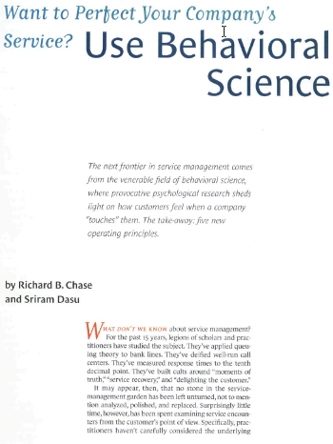

Behavioral science: Improve service system design
Chase, R. B. & Dasu, S. (2001) Want to Perfect Your Company's Service?: Use Behavioral Science. Harvard Business Review.
Notes:
Finally, service worlds can use behavioral science to better understand and improve the human experience dimensions of service, such as waiting in linds.

Slide 22
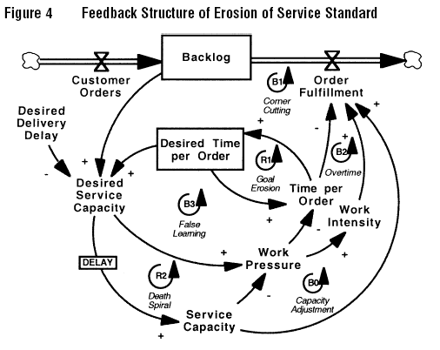
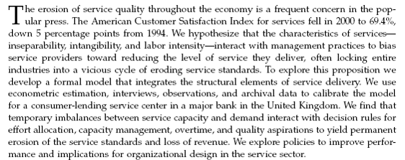
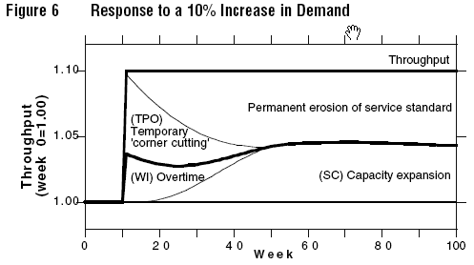
Modeling Service Systems
Oliva, R. & Sterman, J. D. (2001). Cutting corners and working overtime: Quality erosion in the service industry. Management Science, 47, 894 – 914.
Notes:
Assumptions for a model driven enterprise
Human performance is enhanced by artifacts – external props, crib sheets, check list, etc.
- ideosyncratic artefacts created by the person using them have some adv

Slide 23
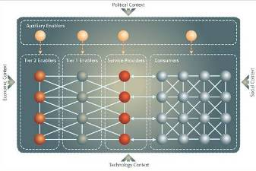
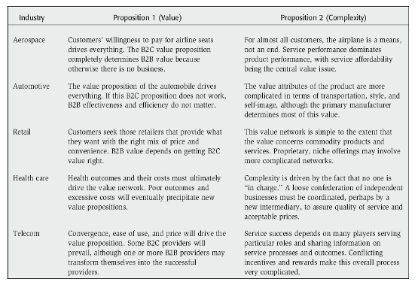
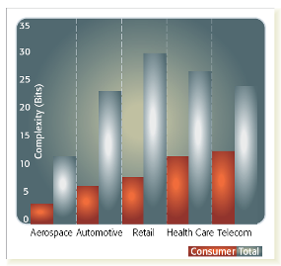
Conceptual model of service value network
Basole, R. C. & Rouse, W. B. (2008). Complexity of service value networks: Conceptualization and empirical investigation. IBM Systems Journal, 47, 53 – 70.
Notes:
More and more articles are appearing that attempt to model service value chains.
http://www.research.ibm.com/journal/sj/471/basol1.jpg

Slide 24
Cross-cultural communication
IBM has > 356,000 employees in 74 countries.
~22% of the IBM workforce is in developing countries, such as India, China, Brazil, and Eastern Europe.
> 52% of IBM's global workforce works in non-traditional environments (home office, client site, or remotely).
Observational Study
  Weekly calls between US and India team
  9.5 hour time difference
  end of day in Bangalore, start of day in New jersey
Ark, W. Shaw, B, Lelescu, A., & Stucky, S. (2008). Data-mining the cross-cultural communication gap. Manuscript under review.

Slide 25
Cross-cultural communication
 | US | India
Technical | 166 | 2
Manager | 417 | 197
Team lead | 753 | 105
Total | 1888 | 304
Turn Taking Behavior
Observational Study
  Weekly calls between US and India team
  9.5 hour time difference
  end of day in Bangalore, start of day in New jersey
Ark, W. Shaw, B, Lelescu, A., & Stucky, S. (2008). Data-mining the cross-cultural communication gap. Manuscript under review.

Slide 26




IBM’s evolution to a globally integrated enterprise
20th
21st
Century
Century
A globally integrated enterprise -- business in a connected world
The international era -- exporting
The multinational era -- replicating
IBM is formally established in 1924 ($11M in revenue; 3384 employees) with sales operations in Canada, Latin America, Europe & Asia; 3 manufacturing facilities completed in Europe by end of decade
“Mini” IBM sales companies established in all major countries of operation, each with full-blown back-office functions e.g., HR, Finance, Marketing, Procurement
Seeded mfg in select countries to temper risk of nationalization
Over 200,000 employees Services Delivery (incl. ISC) across 50 delivery centers in 21 countries
12 Global Shared Services Units
Nearly 2/3 of revenue outside US
Palmisano, S. J. (2006). The globally integrated enterprise. Foreign Affairs, 85, 127 – 136.
Notes:
IBM has transformed itself from an international business (global sales and distribution) to a multinational business (replicated in many nations) to a true globally integrated enterprise. In a globally intergrated enterprise, work happens by drawing on global service centers capabilities seamlessly around the globe.

Slide 27

Service skills, abilities, and knowledge
T-shaped professionals are in
high demand because they
have both depth and breadth
They combine expert thinking
(depth in one or more areas)
and complex communications
(breadth across many areas)
Cross-disciplinary communication
Service system design, management, and modeling
Value co-creation analysis
Service lifecycle analysis (for quality assurance)
Service supply and demand management
New service development
Business project management
Business case development and analysis
Organizational change management
Marketing and sales
Creative and critical thinking
Communication skills
Leadership and collaboration skills
complex communication
expert thinking
Wendy Murphy & Bill Hefley, “What’s new in service science, management, and engineering?”
Presented at Frontiers in Service Conference, October 2008
Notes:
This is a set of skills defined for IBM based on what did not exist in our taxonomy in 2008
Note the focus on interdisciplinary work. Service underlying concepts (vs manufacturing) and the client contribution of value

Slide 28
Service Discipline Classification System
General
  Service Science Education
  Research in Service Science
  Service Science Policy
  History of Services
  Case Studies
  Miscellaneous
Service Foundations
  Service Theory
  Service Philosophy
  Economics of Services
  Theoretical Models of Services
  Mathematical Models of Services
  Service Complexity Theory
  Service Innovation Theory
  Service Foundations Education
Service Engineering
  Service Engineering Theory
  Service Operations
  Service Standards
  Service Optimization
  Service Systems Engineering
  Service Supply Chains
  Service Engineering Management
  Service Systems Performance
  Service Quality Engineering
  New Services Engineering
  Computer Services
  Information Technology Services
  Service Engineering Education
Service Management
  Service Marketing
  Service Operations
  Service Management
  Service Lifecycle
  Service Innovation Management
  Service Quality
  Human Resources Management
  Customer Relationship Management
  Services Sourcing
  Services Law
  Globalization of Services
  Service Business Education
Human Aspects of Services
  Service Systems Evolution
  Behavioral Models of Services
  Decision Making in Services
  People in Service Systems
  Organizational Change in Services
  Social Aspects of Services
  Cognitive Aspects of Services
  Customer Psychology
  Education in Human Aspects of Services
Service Design
  Service Design Theory
  Service Design Methodology
  Service Representation
  Aesthetics of Services
  Service Design Education
Service Arts
  Service Arts Theory
  Traditional Service Arts
  Performance Arts
  History of Service Arts
  Service Arts Education
Service Industries*
  The Service Industry
  Utilities
  Wholesale Trade
  Retail Trade
  Transportation and Warehousing
  Information Services
  Finance and Insurance
  Real Estate and Rental
  Professional and Technical Services
  Management Services
  Administrative and Support Services
  Educational Services
  Health Care and Social Assistance
  Arts, Entertainment, and Recreation
  Accommodation and Food Services
  Public Administration Services
  Other Service Industries
Claudio Pinhanez & Paul Kontogiorgis, “A proposal for a service science discipline classification systems,”
Presented at Frontiers in Service Conference, October 2008

Slide 29
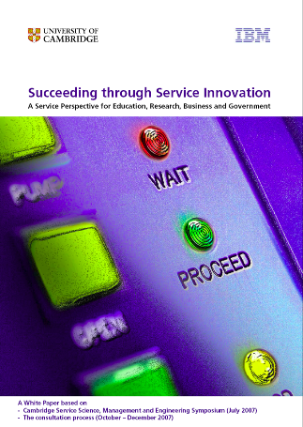
Service Science as “Call to Action”
Service Science is emerging as a distinct field. Its vision is to discover the underlying logic of complex service systems and to establish a common language and shared frameworks for service innovation. To this end, an interdisciplinary approach should be adopted for research and education on service systems.
For education: Enable graduates from various disciplines to become T-shaped professionals or adaptive innovators; promote SSME education programmes and qualifications; develop a modular template-based SSME curriculum in higher education and extend to other levels of education; explore new teaching methods for SSME education.
For research: Develop an interdisciplinary and intercultural approach to service research; build bridges between disciplines through grand research challenges; establish service system and value proposition as foundational concepts; work with practitioners to create data sets to understand the nature and behaviour of service systems create modelling and simulation tools for service systems.
For business: Establish employment policies and career paths for T-shaped professionals; review existing approaches to service innovation and provide grand challenges for service systems research; provide funding for service systems research; develop appropriate organisational arrangements to enhance industry-academic collaboration; work with stakeholders to include sustainability measures.
For government: Promote service innovation and provide funding for SSME education and research; demonstrate the value of Service Science to government agencies; develop relevant measurements and reliable data on knowledge- intensive service activities; make public service systems more comprehensive and citizen-responsive; encourage public hearings, workshops and briefings with other stakeholders to develop service innovation roadmaps.
“Succeeding through Service Innovation” Whitepaper: A Framework for Progress
(http://www.ifm.eng.cam.ac.uk/ssme/)

Slide 30
Summary: “The Cambridge Report”
1. Emerging demand
2. Define the domain
3. Vision and gaps
4. Bridge the gaps
5. Call for actions
Service Innovation
Growth in service GDP and jobs
Service quality
& productivity
Environmental friendly & sustainable
Urbanisation &
aging population
Globalisation & technology drivers
Opportunities for businesses, governments and individuals
Service
Systems
Customer-provider interactions that enable value cocreation
Dynamic configurations of resources: people, technologies, organisations and information
Increasing scale, complexity and connectedness of service systems
B2B, B2C, C2C, B2G, G2C, G2G service networks
Service
Science
To discover the underlying principles of complex service systems
Systematically create, scale and improve systems
Foundations laid by existing
disciplines
Progress in academic studies and practical tools
Gaps in knowledge and skills
Stakeholder
Priorities
Education
Research
Business
Government
The white paper offers a starting point to -
Skills
& Mindset
Develop programmes & qualifications
Knowledge
& Tools
Encourage an interdisciplinary approach
Employment
& Collaboration
Develop and improve service innovation roadmaps, leading to a doubling of investment in service education and research by 2015
Policies
& Investment
Glossary of definitions, history and outlook of service research, global trends, and ongoing debate
“Succeeding through Service Innovation” Whitepaper: A Framework for Progress
(http://www.ifm.eng.cam.ac.uk/ssme/)
Notes:
The Cambridge-IBM whitepaper calls for the creation of national Service Innovation Roadmap (SIR) reports. These are investment guides for improving national service systems.

Slide 31

Worldwide University Programs and SSME
>250 Universities in >50 nations
  Courses that combine business and engineering perspectives
  Various levels: undergrad, masters, and doctoral
    102 degree programs in SSME worldwide
    88 Masters degrees, 14 Bachelors
  Core area of study remains the focus
  Adds breadth and exposure to many service system examples
  Preparing graduates to be adaptive innovators in service-led economies
>25 Service Research Institutes established
  Practical experience and industry participation
  Interdisciplinary teams that focus by industries
  Student competition and award programs

Slide 32
















University Examples
Computer Science
Service Marketing, Management
Service Engineering
MBA SSME Concentration
Technology and Info Mgmt
IT Service Curriculum
Notes:
Samples of universities teaching SSME. Note IBM doesn’t prescribe what to teach but rather invites universities to help develop the science and the discipline around SSME. Note that different universities are teaching SSME in different programs – some in Business, some in Engineering, some in IT Management. IBM requires skils in all these areas….but so do other companies.
US:
CMU – IT Service Mgmt (School of CS)
U Maryland – Business Marketing and Management
Arizona State – Service Marketing
Michigan Technology University – Service Systems Engineering
Missouri State – ITSC
NCSU – MBA Concentration in Service Science
Rochester Institute of Technology – MS Service Mgmt
UC Berkeley – OR and IS
Stevens Institute – Masters IT
LA
Universidad del Salvador, Argentina – Masters in Global Services
ITESM, Mexico – Service Management
EMEA:
University Execter, UK, MS Service Sci and Mgmt
University of Manchester, MS Service Technology & Innovation
Karlstads Universitet, Germany, MS CS, IT
Universitat Karlshrue
University of Porto, Portugal – Service Eng & Mgmt
University Trento – Organizational IS
Scoula Superiore santAnna MAINS, Italy, MS Business
Helsinki Polytechnic Stadia, Master in Service Management
AP
Tsing Hua, China
Peking University - School of Software and Microelectronics, Master of Software Engineering
Sogang Grad School of Business, Korea
Royal Melbourne – Masters Business
Singapore Management University – SSME

Slide 33
Worldwide Service Research Centers (>27 Total)
Bahcesehir and Northeastern (Turkey) Universities
Innovation University: Helsinki University of Technology (HUT)=Design Factory, Helsinki School of Economics HSE)= Service Factory and Helsinki University of Arts and Design (UAD)=Media
India SP Jain Institute for Management SSME Center
Karlsruhe Service Research Center
Shanghai Research Center (Charles King, Pund-IT)
National Tsinghua Institute for Service Science
University of Amsterdam and the VU University Amsterdam will launch one of the first European university centers for service innovation
University Federal de Rio de Janeiro SSME Research Group

Slide 34
Worldwide Government Programs
>18 Nations have held events, written papers
  Basic statistics on jobs, businesses, GDP, Import/Export, growth
  Typically, focus on a few key industries (health care, financial, etc.)
  Often tied to growth of entrepreneurship and new e-service offerings
  A few have made government e-service offerings a priority
  Identify leading university programs
  Identify leading industrial research organizations
  Identify government research and funding programs
  Identify public-private stakeholder organizations to drive agenda
  Establish recommendations going forward

Slide 35









Industry Response:
SRII - Service Research & Innovation Institute
Notes:
Note that industry is most often tied to academics in the efforts around service science, as industry needs academe to produce graduates capable of work in in tomorrow’s service science settings. One such global initiative is the Service Research and Innovation Initiative (SRII) whose member organizations are shown here.
Links:
http://forums.thesrii.org/srii - the community SRIC
http://thesrii.org/initiative.asp - the initiative - SRII
The Service Research and Innovation Initiative (SRII) is striving for the following commitments:
Corporations - Commit to funding a permanent service R&D budget; active involvement in the Service Research and Innovation Community (SRIC) and work with government and academia to develop service research.
Governments - Sponsor research in universities and applied research centers; get involved in the SRIC; work with industry and academia to develop service research.
Academic Institutions - Increase core research in services, establish curricula, programs and degrees for service disciplines (e.g. management, operations, design, etc.); collaborate with industry to develop research in commercially relevant areas; get involved in the SRIC.
Mission
To increase the amount of funded and targeted services research,
development and innovation in the technology industry.
Strategy
Establish an active community that joins industry, academic and gov’t thought
leaders to inspire and drive the required funding, research & innovation
necessary to effect service innovation.
Phase 2 - Aggregation
Act as the central aggregator of relevant content, people, events, business needs and research funding opportunities for services research and innovation.

Slide 36




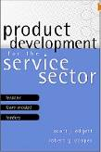
New Service Science Books
Service Science, Management and Engineering: Education for the 21st Century; Hefley, Bill; Murphy, Wendy (Eds.)
Services Science: Fundamentals, Challenges and Future Developments; Stauss, B.; Engelmann, K.; Kremer, A.; Luhn, A. (Eds.)
Advances in Services Innovations; Spath, Dieter; Fähnrich, Klaus-Peter (Eds.)
Competing in a Service Economy: How to Create a Competitive Advantage Through Service Development and Innovation, Michael D. Johnson, Anders Gustafsson
New Service Development and Innovation in the New Economy, Bo Edvardsson, Anders Gustafsson, Michael D. Johnson, Bodil Sanden
Product Development for the Service Sector: Lessons from Market Leaders, Robert G. Cooper, Scott J. Edgett

Slide 37
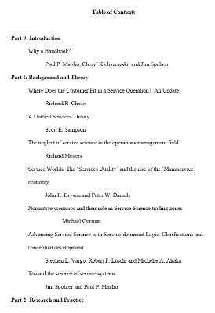

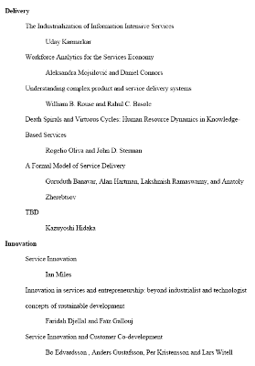
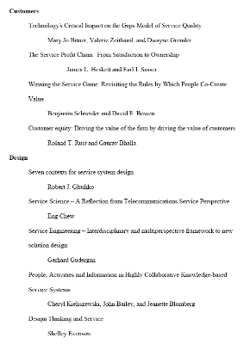
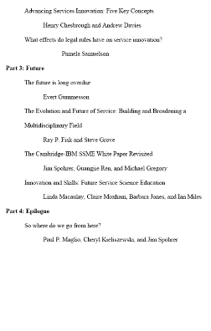
Handbook of Service Science, forthcoming…
Maglio, P. P., Kieliszewski, C., & Spohrer, J. (forthcoming). Handbook of service science. New York: Springer.

Slide 38
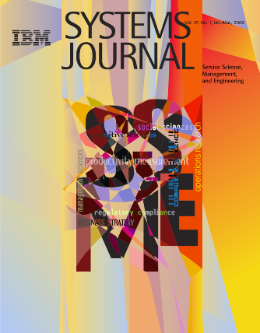
So what is service science?
Service is value-cocreation, that is, useful changes that result from communication, planning, or other purposeful interactions between distinct entities.
A service system is a collection of entities and interactions that cocreate value, that is, a set of distinct configurations of resources (including people, organizations, shared information, and technology) that are better off working together than working alone.
Service Science aims to create a body of knowledge that describes, explains, predicts, and improves value-cocreation between entities as they interact, that is, relying on methods and standards used by a community to account for observable phenomenon with conceptual frameworks, theories, models, and laws that can be empirically tested.
So the object of study value-cocreation, the basic abstraction is the service system, and the ultimate goal is develop methods and theories that can be used to explain and improve value-cocreation in service systems.

Slide 39
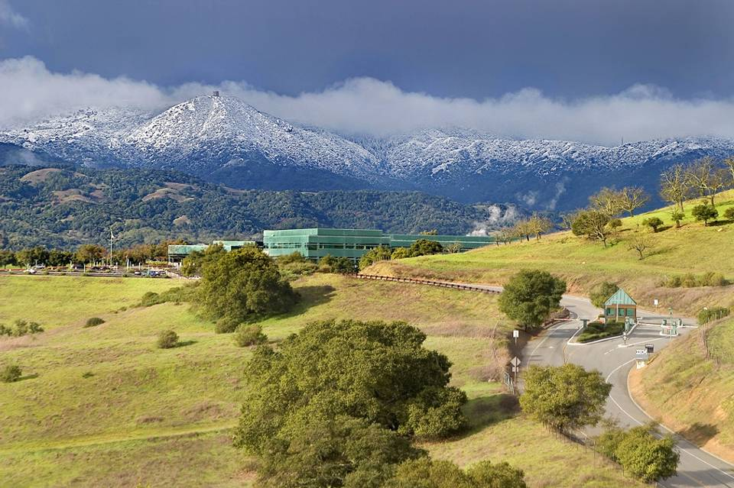

http://www.ibm.com/university/ssme

